Slide 1
Siddaganga Institute of Technology, Tumakuru
Department of Computer Science and Engineering
Open-ended project presentation
on
RECOGNIZING ORGANIC AND RECYCLABLE WASTE USING CNN
by
Sharanabasava 1SI17CS098
Vrushanka P 1SI17CS132
Ashik B.S 1SI17CS402
Panel Member
K S Chandraprabha M.Tech
Assistant Professor
Dept. of Computer Science & Engg.

Slide 2
Contents
Introduction
Problem statement and Objective
Proposed System and System Design
Result
Conclusion

Slide 3
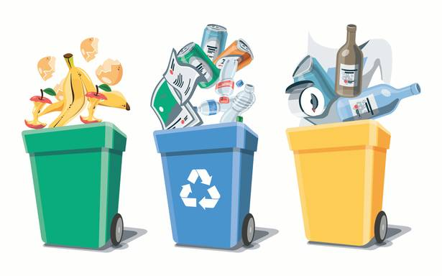
Introduction
Due to the rapid industrialization and urbanization causes an extraordinary increase in the organization of unwanted wastes.
To avoid increase in unwanted waste we come up with Waste segregation process leads to recycling of waste
The waste becomes valuable if it is segregated and recycled

Slide 4
Problem statement and Objective
To design and develop a method for which takes the dataset of images of the waste as the input, then the model is trained with the training set .The trained model will be able to recognize and classify the images of waste as organic and recyclable.
To segregate the waste consisting of household, electronic, and general waste into organic and recyclable.
To apply machine learning and convolutional neural networks to make the segregation easier, faster and more efficient.
A Convolutional Neural Network (CNN ) is a class of deep, feed-forward network that has been applied to analyses visual imagery.

Slide 5
PROPOSED SYSTEM
Dataset
Splitting data
Training
validation
Testing
Convolution neural network
Extract features
Evaluate
Training model
New classification
Fig 2: System Architecture of evaluation of waste image

Slide 6
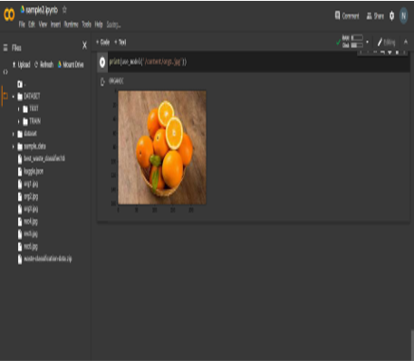
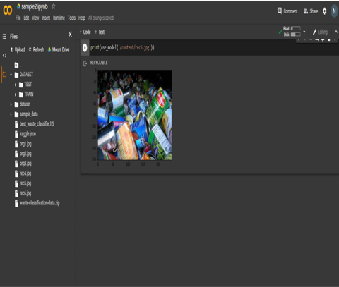
Result
Fig 1: Snapshot of images recognized as organic waste

Slide 7
CONCLUSION
The sorting of garbage into different categories of recycling is possible through machine learning and computer vision algorithms.
This system isolates waste automatically into metal , plastic, or wet waste utilizing no sensor.
The System is limited to the objects which looks like metals but not metals.

Slide 8
“THANK YOU”

